Slide 1
DATABASES

Slide 2
Introduction to SQL
SQL is a standard language for accessing and manipulating databases.
SQL stands for Structured Query Language
SQL lets you access and manipulate databases
SQL became a standard of the American National Standards Institute (ANSI) in 1986, and of the International Organization for Standardization (ISO) in 1987

Slide 3
What Can SQL do?
SQL can execute queries against a database
SQL can retrieve data from a database
SQL can insert records in a database
SQL can update records in a database
SQL can delete records from a database
SQL can create new databases
SQL can create new tables in a database

Slide 4
Using SQL in Your Web Site
To build a web site that shows data from a database, you will need:
An RDBMS database program (i.e. MS Access, SQL Server, MySQL)
A server-side scripting language, like PHP or ASP
to use SQL to get the data you want
To use HTML / CSS to style the page

Slide 5
RDBMS
RDBMS stands for Relational Database Management System.
RDBMS is the basis for SQL, and for all modern database systems such as MS SQL Server, IBM DB2, Oracle, MySQL, and Microsoft Access.
The data in RDBMS is stored in database objects called tables.
A table is a collection of related data entries and it consists of columns and rows.

Slide 6
Database options using php
PHP Connect to MySQL
PHP 5 and later can work with a MySQL database using:
MySQLi extension (the "i" stands for improved)
PDO (PHP Data Objects)
Earlier versions of PHP used the MySQL extension. However, this extension was deprecated in 2012.
MySQLi Installation
For Linux and Windows: The MySQLi extension is automatically installed in most cases, when php5 mysql package is installed.

Slide 7
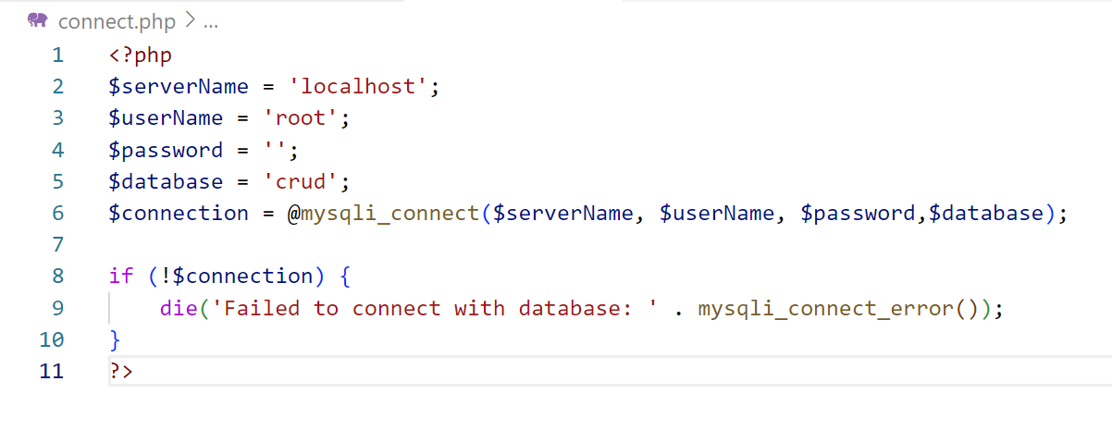
Open a Connection to MySQL
Before we can access data in the MySQL database, we need to be able to connect to the server:

Slide 8
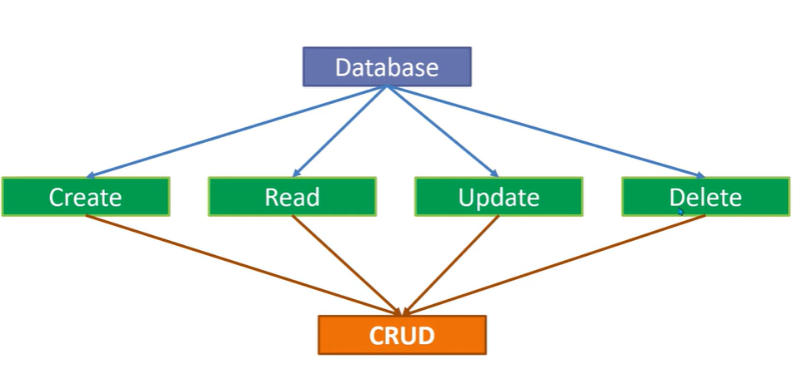

Slide 9

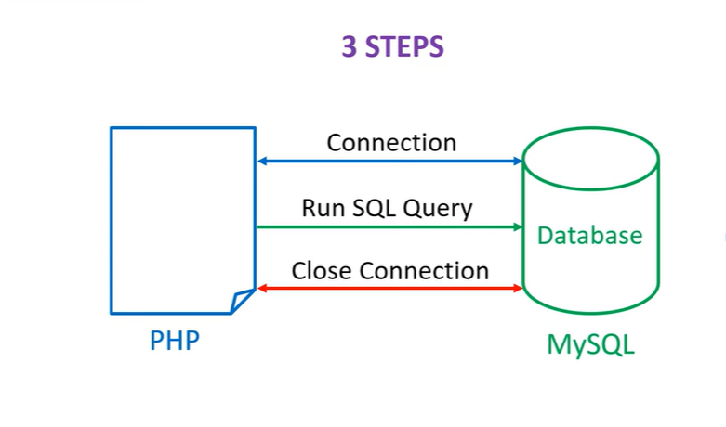

Slide 10
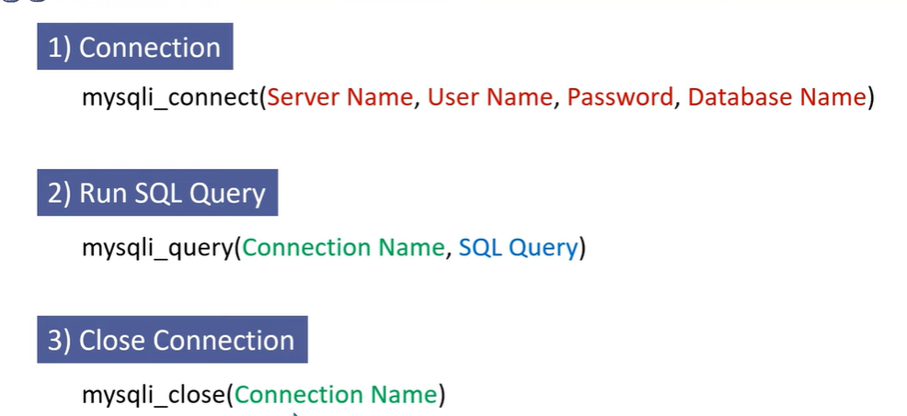

Slide 11
CREATE A CONNECTION
$connection= mysqli_connect(“localhost”, ”username”, “password”, ”database name”)

Slide 12
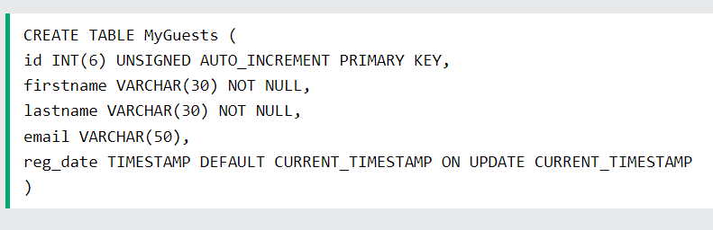
PHP MySQL Create Table
A database table has its own unique name and consists of columns and rows.
Create a MySQL Table Using MySQLi
The CREATE TABLE statement is used to create a table in MySQL.
We will create a table named "MyGuests", with five columns: "id", "firstname", "lastname", "email" and "reg_date":

Slide 13
PHP MySQL Insert Data
Insert Data Into MySQL
After a database and a table have been created, we can start adding data in them.
Here are some syntax rules to follow:
The SQL query must be quoted in PHP
String values inside the SQL query must be quoted
Numeric values must not be quoted
The word NULL must not be quoted
The INSERT INTO statement is used to add new records to a MySQL table:

Slide 14
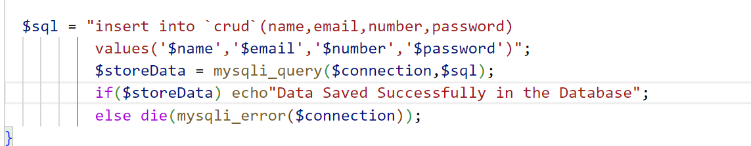

Slide 15
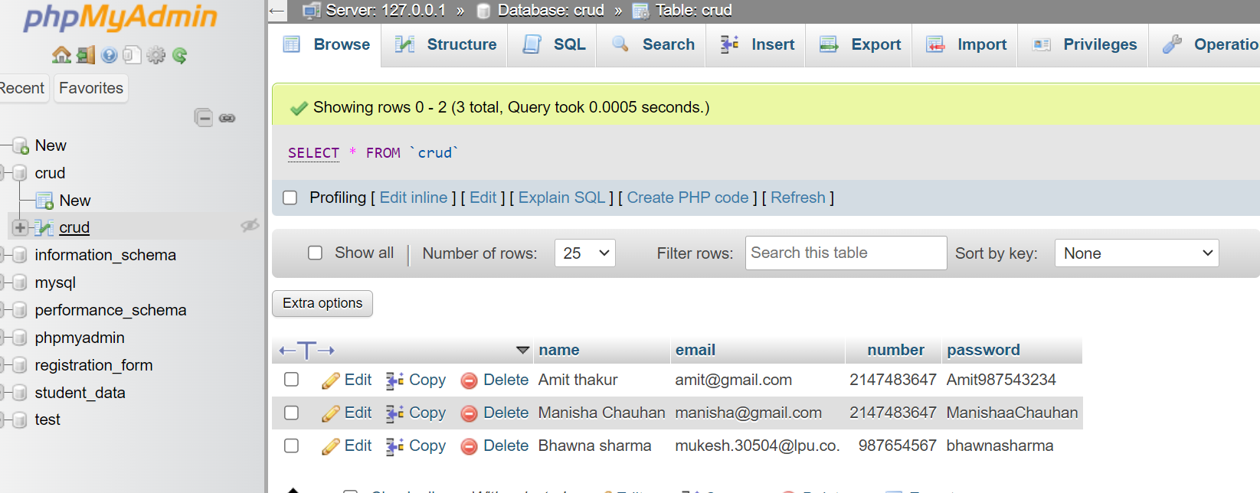

Slide 16
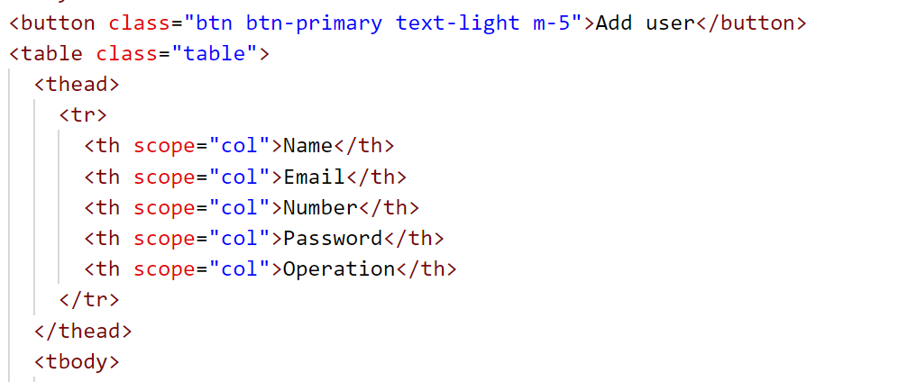
Display data
If you wish to display data from database on your webpage

Slide 17
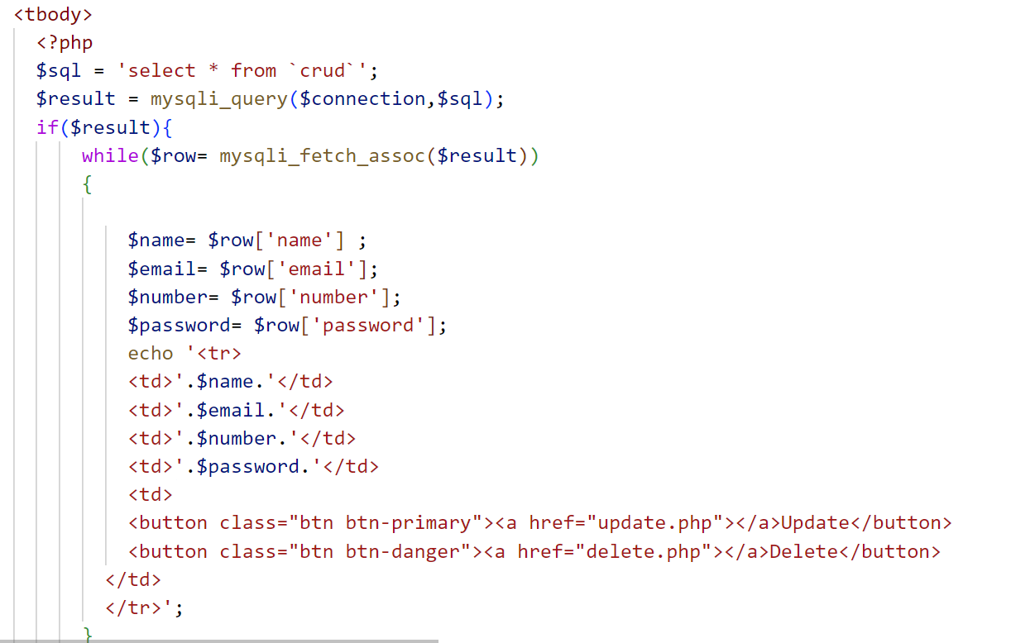

Slide 18
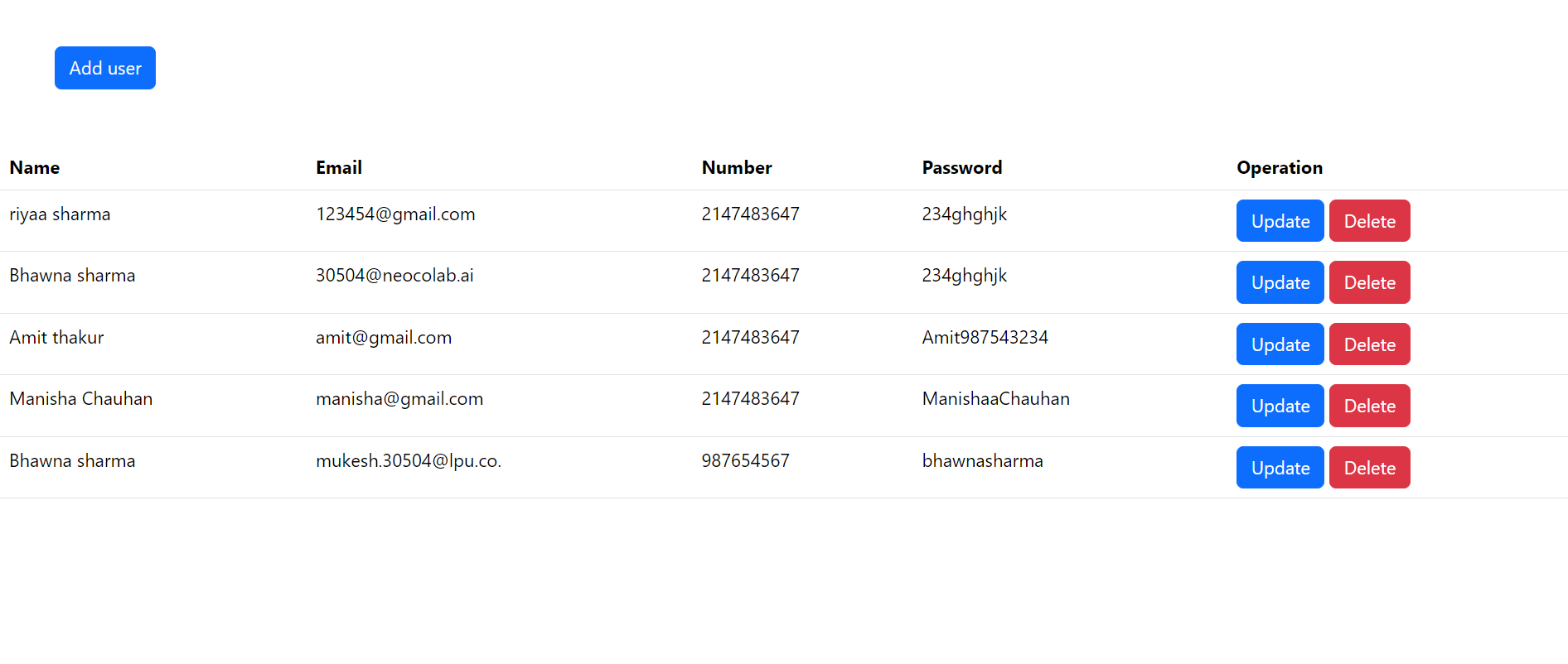

Slide 19
Delete
If you wish to delete data from database
First you need to get the primary key

Slide 20
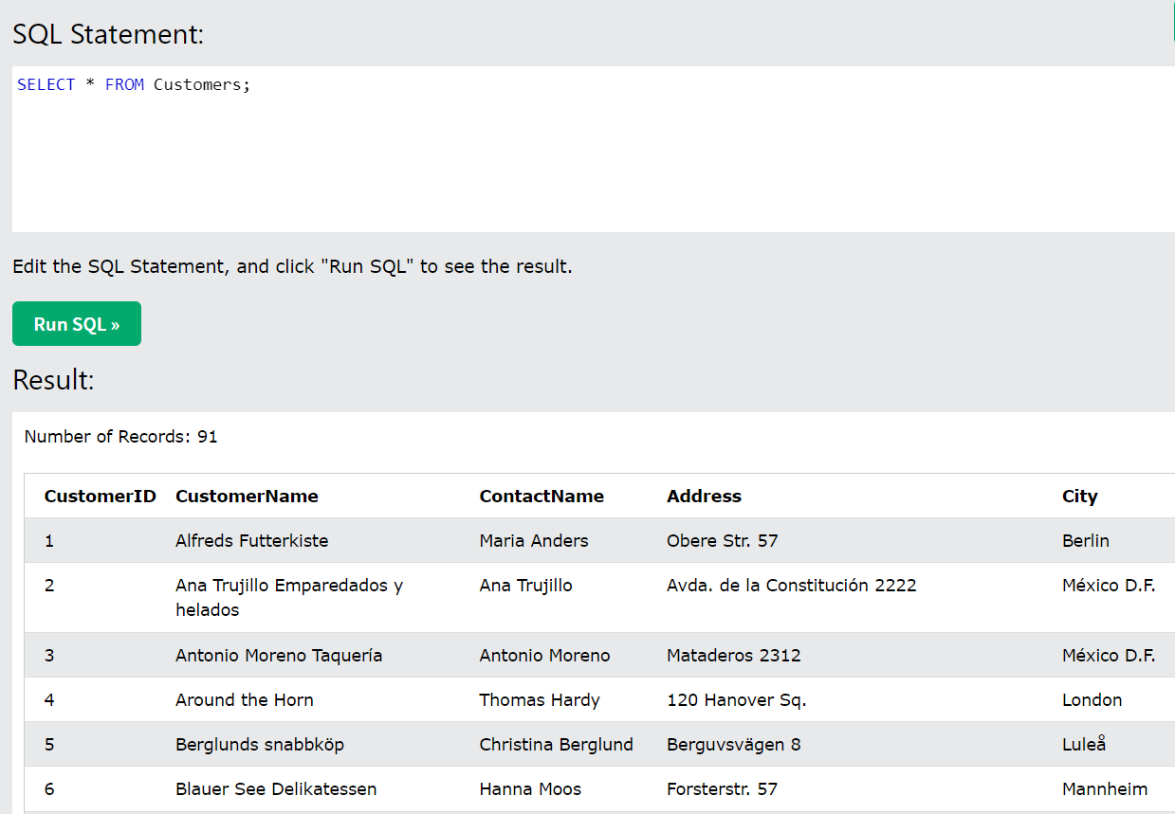

Slide 21
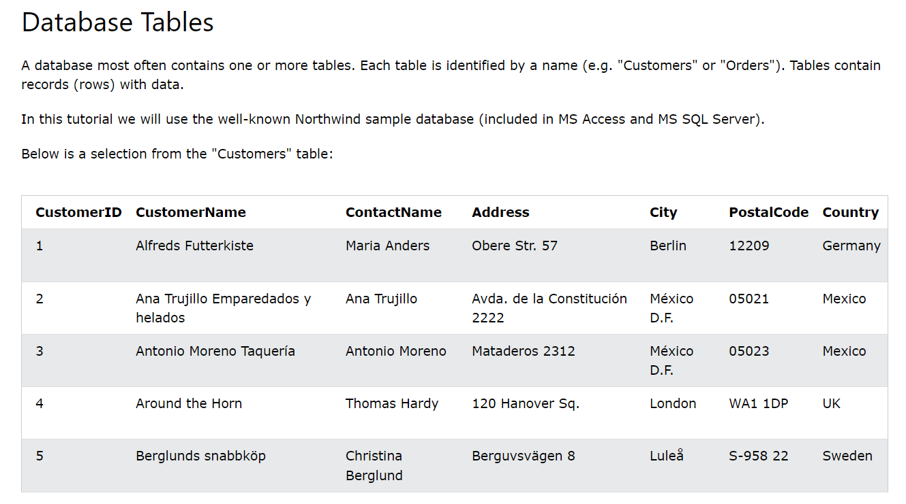

Slide 22
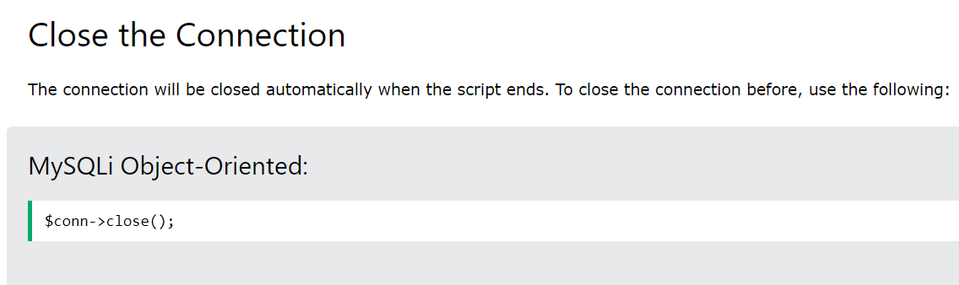

Slide 23
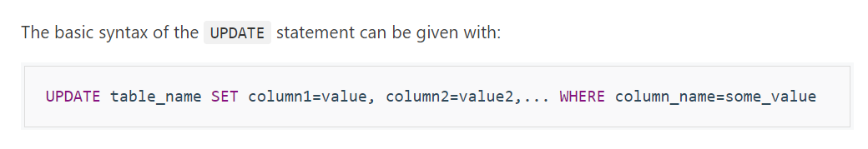
Updating Database Table Data
The UPDATE statement is used to change or modify the existing records in a database table. This statement is typically used in conjugation with the WHERE clause to apply the changes to only those records that matches specific criteria.
The basic syntax of the UPDATE statement can be given with:

Slide 24
UPDATE
<?php
$conn = mysqli_connect("localhost", "root", "", "demo");
if($link === false){
die("ERROR: Could not connect. " . mysqli_connect_error());
}
$sql = "UPDATE persons SET email='peterparker_new@mail.com' WHERE id=1";
if(mysqli_query($conn, $sql)){
echo "Records were updated successfully.";
} else {
echo "ERROR: Could not able to execute $sql. " . mysqli_error($conn);
}
mysqli_close($conn);
?>

Slide 25
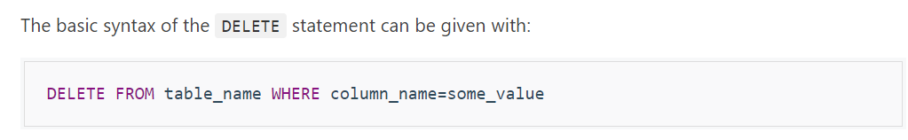
DELETE
Deleting Database Table Data
Just as you insert records into tables, you can delete records from a table using the SQL DELETE statement. It is typically used in conjugation with the WHERE clause to delete only those records that matches specific criteria or condition.
The basic syntax of the DELETE statement can be given with:

Slide 26
DELETE
<?php
$conn = mysqli_connect("localhost", "root", "", "demo");
if($conn === false){
die("ERROR: Could not connect. " . mysqli_connect_error());
}
$sql = "DELETE FROM persons WHERE first_name='John'";
if(mysqli_query($conn, $sql)){
echo "Records were deleted successfully.";
} else{
echo "ERROR: Could not able to execute $sql. " . mysqli_error($conn);
}
mysqli_close($conn);
?>

